Slide 1
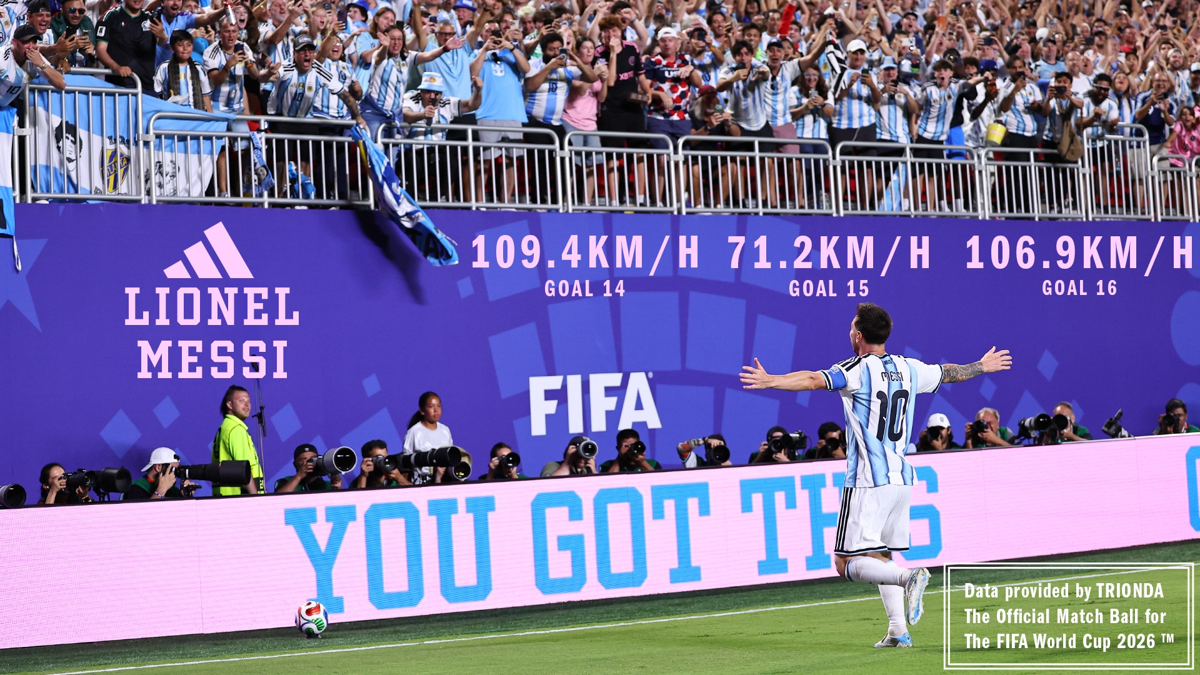
Lionel Messi International Career Performance Analysis
Hareesh Patel | MBA Graduate | Data Analytics Intern
Career Analysis – Lionel Messi
Why Lionel Messi?
Lionel Messi was selected for this analysis because of his exceptional international career, consistent goal-scoring record, and significant contributions across multiple tournaments. His long career timeline provides an excellent opportunity to study performance evolution, identify peak years, and analyze major career milestones.
Project Overview:
Objective: Leverage data analytics to evaluate Lionel Messi’s international career trajectory and overall impact on the field.
Scope: Analyze historical match records, goal-scoring patterns, and tournament-specific performance metrics.
Key Deliverables: Data-driven visualizations highlighting performance evolution, peak scoring years, and major career milestones.

Slide 2

Project Objectives
Evaluate Goal Efficiency: Measure Lionel Messi’s goal-scoring consistency and peak performance cycles across his international career.
Identify Performance Drivers: Analyze performance variations across major tournaments (FIFA World Cup, Copa América) vs. Friendlies.
Assess Tactical & Match Context: Measure the impact of match venues, team dominance, and critical career milestones on overall goal output.
Build Predictive Baselines: Establish data-driven benchmarks for longitudinal player tracking and performance forecasting models

Slide 3
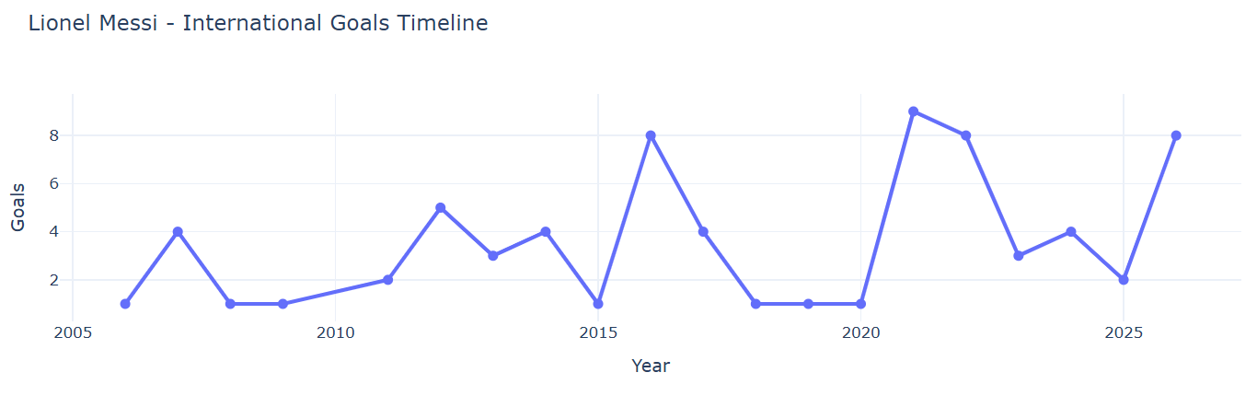
Player Career evolution Analysis
Lionel Messi's international career can be divided into six distinct phases:
• Early Development Phase (2006–2011)
• Performance Growth Phase (2012–2015)
• Prime Scoring Phase (2016–2017)
• Transitional Phase (2018–2020)
• Peak International Success (2021–2022)
• Experienced Leadership Phase (2023–2026)
• Overall, Messi's career reflects steady development, remarkable consistency during his prime years, and sustained high-level performance over nearly two decades of international football.

Slide 4
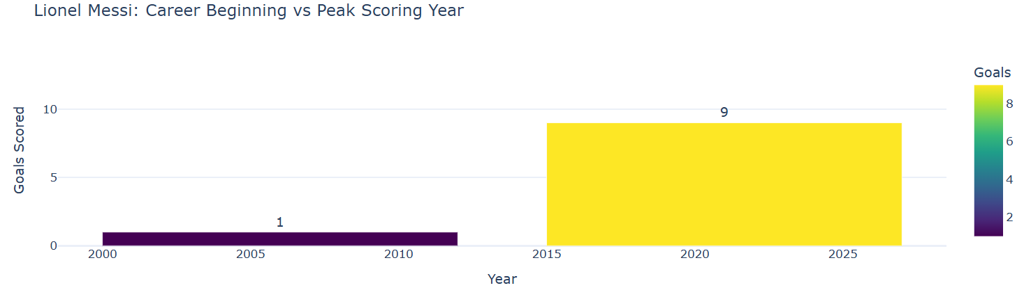
Career Timeline Analysis
Observation:
• Lionel Messi scored only 1 goal during the beginning of his international career in 2006
• His highest international goal tally came in 2021, when he scored 9 goals.-
• This comparison reflects his remarkable growth, consistency, and evolution into one of football's greatest international goal scorers.

Slide 5
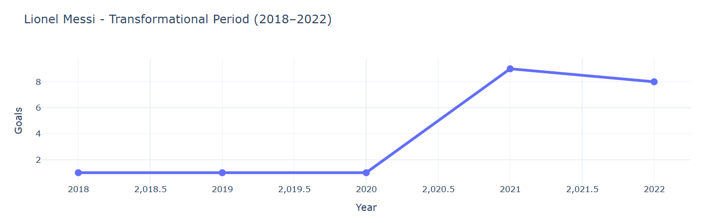
Key Career Milestones:
• Won the 2021 Copa America, securing his first major international trophy with Argentina.
• Delivered outstanding performances throughout the tournament and emerged as one of the team's most influential players.
• Continued this momentum into 2022, playing a decisive role in Argentina's FIFA World Cup-winning campaign.
• These achievements marked the peak of his international career and strengthened his legacy as one of football's greatest players.
Transformational Period Analysis
• The period between 2020 and 2022 represents the most significant transformation in Lionel Messi's international career.
• After recording only 1 international goal in 2020, Messi's performance improved dramatically, reaching 9 goals in 2021 and maintaining 8 goals in 2022.
• This remarkable rise reflects one of the strongest phases of his international career and highlights his ability to deliver consistently during major international competitions.

Slide 6
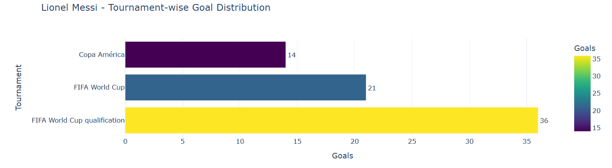
Tournament Performance Analysis
Lionel Messi scored international goals across three major competitions:
• FIFA World Cup Qualification was his most productive competition, with 36 goals, highlighting his consistent performances during qualification campaigns.-
• He scored 21 goals in the FIFA World Cup, demonstrating his ability to perform on football's biggest stage.
• In Copa América, Messi registered 14 goals, making significant contributions in South America's premier international tournament. Overall, Messi maintained a strong scoring record across both qualification matches and major international tournaments, reflecting his consistency and longevity at the highest level.

Slide 7
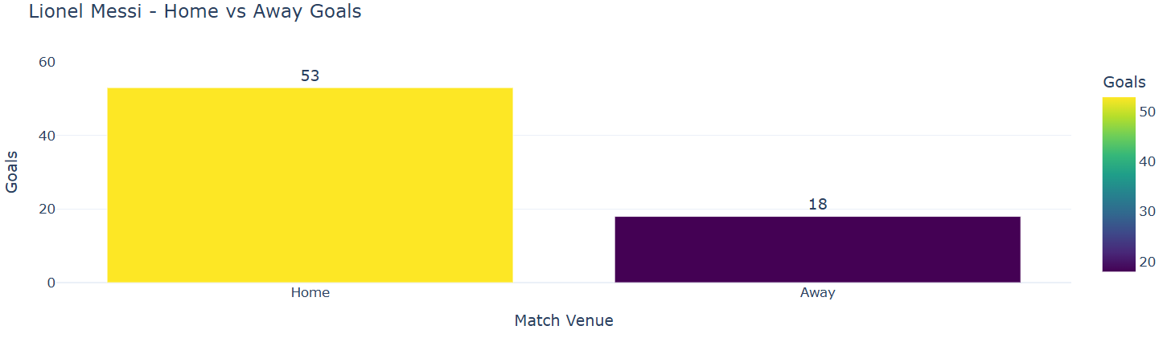
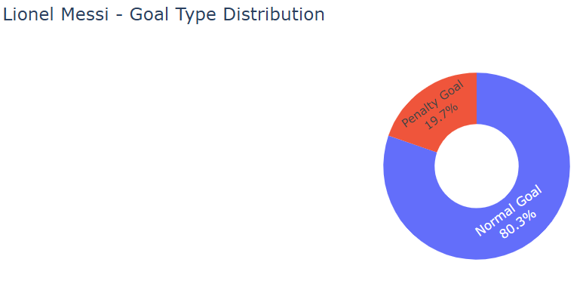
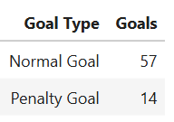
Home vs Away Performance Analysis
Goal Type Analysis
Total Goals :71
• Lionel Messi scored the majority of his international goals through open play, with 57 normal goals, highlighting his creativity, positioning, and finishing ability.
• He also converted 14 penalty goals, demonstrating composure and reliability in high-pressure situations.
• The distribution indicates that Messi's goal-scoring success has primarily been driven by overall attacking play rather than penalties alone.
Lionel Messi scored 53 goals in home matches and 18 goals in away matches throughout his international career.
The higher goal tally in home fixtures suggests greater attacking productivity in familiar playing conditions. However, his 18 away goals demonstrate his ability to consistently perform and contribute even in challenging environments, reflecting his adaptability and world-class consistency across different venues.

Slide 8
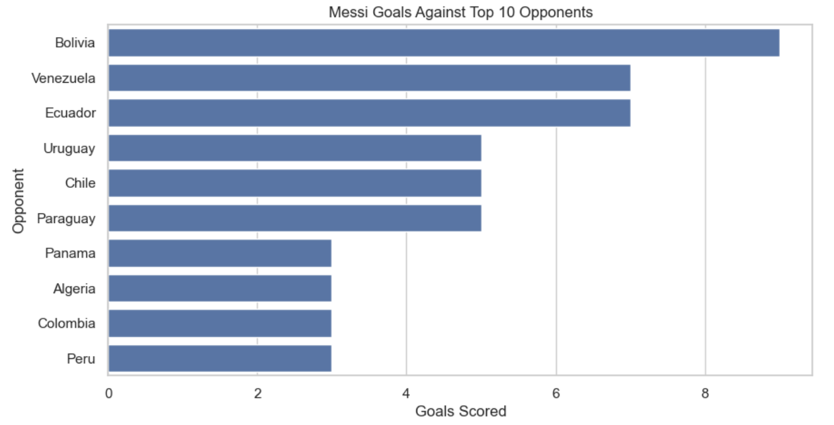
Opponent Analysis
Lionel Messi has scored against a wide range of international opponents, demonstrating his consistency across different competitions.
• Bolivia was his most successful opponent with 9 goals.
• He also scored 7 goals each against Venezuela and Ecuador.
• Strong performances against Uruguay, Chile, and Paraguay further highlight his effectiveness against top South American teams. This distribution reflects Messi's long-term dominance in CONMEBOL competitions and FIFA World Cup qualification campaigns.

Slide 9
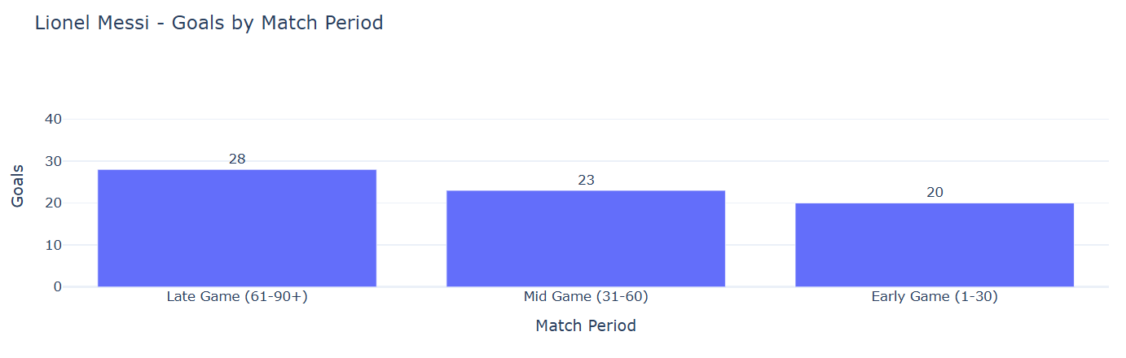
Goal Timing Analysis
Key Insights:
• Messi remained an effective goal scorer throughout the match, contributing in the early, middle, and late phases.
• His goal distribution shows that he was capable of creating scoring opportunities regardless of the match stage.
• The strong presence in the late stages highlights his ability to influence important moments when matches become more competitive.
• The balanced scoring pattern reflects his consistency, tactical awareness, and endurance over the full duration of a game.
Messi's goal-scoring pattern demonstrates his ability to remain a constant attacking threat from kickoff until the final whistle, showcasing exceptional consistency and match-winning impact throughout his international career.

Slide 10
Conclusion
• This analysis provides a comprehensive overview of Lionel Messi's international football career using data-driven insights.
• The study highlights Messi's evolution from a young emerging talent to one of the greatest footballers in international history.
• The analysis identified key performance areas including:
- Career growth and peak scoring years
- Tournament-wise contributions
- Opponent-wise goal performance
- Home vs away consistency
- Goal timing and scoring patterns
• Messi demonstrated exceptional consistency over nearly two decades, maintaining a high level of performance across different competitions and match conditions.
• The 2021 Copa America victory and 2022 FIFA World Cup campaign emerged as defining phases of his international career, showcasing his leadership, adaptability, and ability to perform under pressure.
• The findings indicate that Messi's success was built on sustained excellence, technical ability, and consistent contribution rather than isolated performances.
• Overall, this analysis reinforces Lionel Messi's legacy as one of the most influential and impactful players in modern international football.

